Slide 1
GRANARY UG PROJECT
BY ASINGURA K PHILIP

Slide 2
Introduction
Uganda is an agriculturally-based country where a significant portion of the population relies on farming as a primary source of livelihood. Agriculture plays a central role in the national economy, food security, and rural development. However, despite the heavy reliance on farming, many smallholder farmers struggle with post-harvest losses due to limited access to modern processing and storage facilities. This report explores how Granary Ug can address these challenges by providing solutions for drying and storing produce, ultimately aiming to improve crop quality and farmer incomes.

Slide 3
Problem Statement
Unpredictable weather conditions, lack of reliable drying systems, and insufficient storage infrastructure have led to significant post-harvest losses among Ugandan farmers. These losses result in reduced income, compromised food quality, and limited market competitiveness. Farmers lack access to modern solutions that can improve the shelf life and value of their produce. Without intervention, these challenges will continue to hinder agricultural productivity and economic advancement.

Slide 4
System Objectives
Centralize farmer and produce records
Monitor environmental conditions
Ensure capacity limits
Automate tasks and enforce business rules
Generate invoices based on services used

Slide 5
Key Entities
• Farmer: Can have multiple produce entries.
• Manager: Registers farmers and produce.
• Produce: Belongs to one farmer; may be stored, dried, or both.
• Storage Unit: Holds produce; tracks temperature/humidity; managed by a Storekeeper.
• Storekeeper: Manages one or more storage units.
• Drying Unit: Processes drying batches; managed by a Drying Expert.
• Drying Expert: Oversees one or more drying units.
• Drying Batch: Group of produce to be dried in a drying unit.
• Dryer Machine: Operates under a drying unit.
• Invoice: Generated based on services offered.

Slide 6
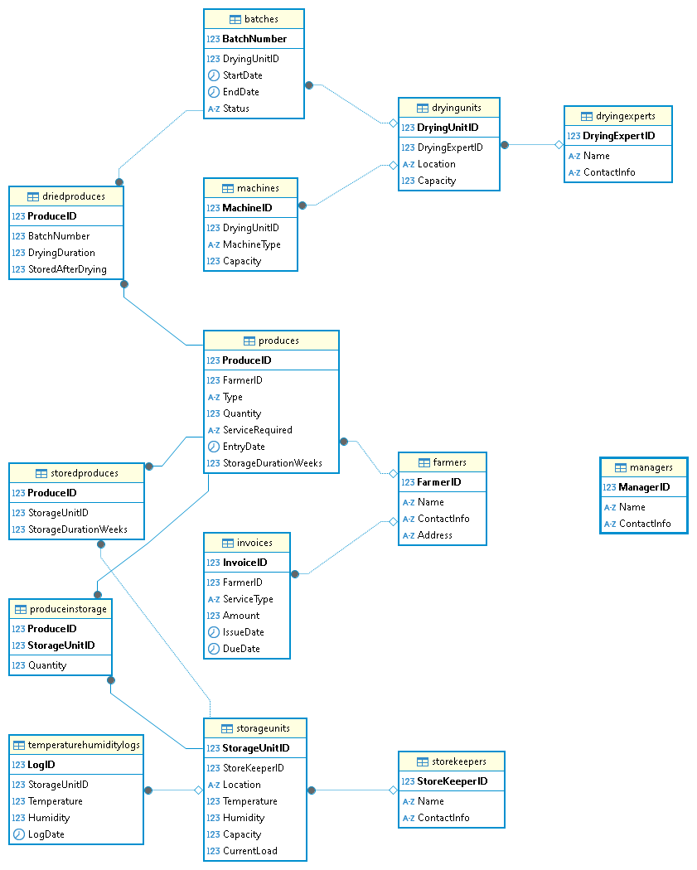
Entity Relationship
Diagram (ERD)

Slide 7
Roles and Access Control
Defined user roles: Manager, Storekeeper, Drying Expert, Admin
Privileges and views assigned to each role
Enforces data security and workflow separation

Slide 8
Business Rules
One manager handles several farmers
One farmer can have many produce
One produce belongs to one storage unit or one drying batch Storage/drying units have limited capacity
Only designated users can perform certain operations

Slide 9
Benefits of this system
Better traceability
Data consistency
Secure multi-role access
Easy invoicing
Ready for scalability (e.g. mobile app, SMS alerts)

Slide 10
THE END

